Slide 1
Unsupervised Learning of the Morphology of a Natural Language
John Goldsmith, University of Chicago, 2001
https://www.aclweb.org/anthology/J01-2001.pdf
(presented by Vilém Zouhar, 2020)

Slide 2
Task
p. 153-155
“Given unannotated plaintext data, produce morphological annotations.”
Doesn’t work well with languages with high average number of affixes
Input: data sized 5KW-1MW
Output: segmentation of every input word + categories of such segments
(although the categories are alg. internal and don’t map to “our” classes)
Automated tool > faster and cheaper than manual work
Great for bootstrapping other grammar systems
Two parts: splitting words + determining possible suffixes (+common classes)

Slide 3
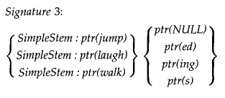
Minimum Description Length Model
First model
p. 164, 166, 167
Compressing corpus ∝ Morphological analysis
(best compression, but given a specific “morphological” structure)
At most one suffix
signature = affix set
p(stem+aff.) =
p(sig.)p(stem|sig.)p(aff.|sig.)
We want to target the lowest entropy distribution of p, so that it can be compressed effectively.

Slide 4
Recursive structure
MDL - motivation
p. 168
allow { {work}{-, -ing} }{-, -s}
but in this case add a flag to disallow work-s
MDL cannot create morphologies itself
But when we give it two morphologies M₁, M₂ we can say which one is better according to their probabilities (compressed sizes) in MDL (minimum description model)

Slide 5
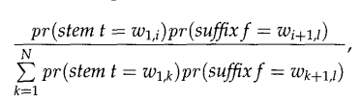
Word Segmentation (0th) Heuristics
p. 170, 171
Can suggest morphologies for MDL
Based on Expectation-Maximization
|w| stem+suff. hypothesis for a word w (cut at every index)
Zeroth heuristic: normalize the cut probability as
This fails (creates suffixes sized 1)

Slide 6
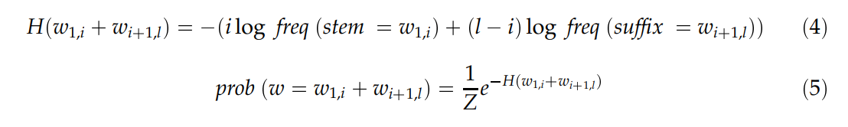

1st Heuristic
p. 171, 172
Named take-all-splits
Models splits using a Boltzmann distribution
This promotes longer suffixes
We now have split for every word

Slide 7

2nd Heuristic
p. 172
Count all suffixes of size 2-6
(6 chosen because we don’t expect suffixes larger than that)
Model the probability of this being a morpheme as:
We choose 100 most probable suffixes
Errors {-ting,-ing}
Erros {de-}{-fense,-mand,-lete}
Many words will then obtain multiple different splits
We can use MDL to choose the more probable ones

Slide 8
Intermediate Results 1 Cleanup
p. 173, 174
MDL gives us the best parse for each word
Stems and suffixes can be taken from this description
Singleton signatures removed (>90%)
Signatures of size 1 removed
The rest is called regular (stems/suffixes)
Example from Tom Sawyer:
Signatures: {-,-ed,-ing}, {-e,-ed,-ing}

Slide 9
Intermediate Results Cleanup - errors
p. 174, 175
Two suffixes collapsed into one: -ings, -ments
Common stem endings in suffixes: -ts
-s is a good suffix candidate, but not all words ending with -s have this suffix
(in a morphological sense)
Same (morphological) stem has different (“infered”) stems:
{abbreviate}{-,-d,-s} vs. {abbreviat}{-ing}
In the previous case, the stem is not split consistently.
In case of {win}{-,-s} and {winn}{-er,-ing} we want the stems to be connected.
Q: What’s the difference between 4 and 5?

Slide 10
Cleanup - Procedure - 1, 2
p. 176, 177
Modify the morphology and compare MDL’s outputs
If the compressed length is lower, then accept this change
In 1 suffixes can be split into e.g. {-ings} -> {{-ing}{-,-s}} and checked in MDL
This can be done by checking whether it is composed of two already existing suffixes
2 can be fixed by examining signature prefixes e.g. {-te,-ting,-ts}
Try dropping t and if MDL decreases, then accept this
(related problem “what if -t is a suffix” discussed later)

Slide 11
Cleanup - Procedure - 3 (triage)
p. 177, 178, 185
For 3 we take a look at suspicious suffixes: either with too low or too high number of stems. E.g. {boo,loo,}{-t,-l}
Short suffixes are suspicious.
How much data we need to say that a signature is plausible?
Does adding the suffix back to the stem decrease MDL? If so, accept the change.
Q: Solution to 4, 5?

Slide 12
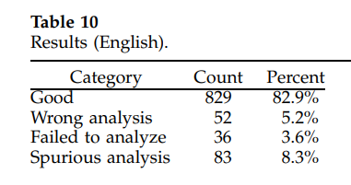
Intermediate Results 2
p. 178, 179, 183, 184
After implementing the cleanup solutions, we get somewhat better results
{-,-ed,-ing,-s} (corresponds to verbs)
{-,-s} (corresponds to nouns)
Good = good
Wrong = segmented, but wrongly
Failed = not segmented
Spurious = segmented, but shouldn’t be

Slide 13
Endnotes
p. 186-189
This algorithm doesn’t deal with relating signatures together
(because given a signature S₁, there is likely to be S₂ ⊂ S₁ and S₁ may or not may be morphologically related to S₂)
Allomorphs are disregarded.
Compounds are disregarded.
Substractive morphemes are work in progress.
We want {-e,-ed,-es,-ing} to be {-,-ed,-ing,-s} for lov/love
But for this we would need a deletion operator to do love-<x>-ing

